Slide 1
Project Scheduling
Phil Pfeiffer
Fall, 2014

Slide 2
Scheduling
5th of 6 major tasks in project time management
▪ Defining activities (WBS)
▪ Sequencing activities
▪ Estimating activity resources
▪ Estimating activity durations
▪ Developing the schedule
▪ Accounts for sequences, resources, durations
▪ Controlling the schedule
Most visible, perhaps, because time easiest to measure
What a schedule includes at minimum –
start, finish dates for each task
Schwalbe, Kathy, Information Technology Project Management, 6th Ed.

Slide 3
Defining Activities
Activity list - list of activities to do.
For each activity
▪ name, ID, description
▪ attributes
▪ predecessor and successor tasks
▪ dependent task relationships
▪ finish-start, finish-finish, start-start, start-finish
▪ leads, lags
▪ resource requirements
▪ constraints
▪ imposed dates
▪ assumptions
Schwalbe, Kathy, Information Technology Project Management, 6th Ed.

Slide 4
Defining Activities - Task Relationships
Dependencies
▪ finish-start
Finish bringing water to boil before adding pasta.
▪ finish-finish
Finish chopping onions before stopping the kitchen fan.
▪ start-start
Start the blender before starting to add ice.
▪ start-finish
Start serving coffee before finishing main meal dishes.
Lead-lag
▪ lead – an acceleration in the start time of a second task,
relative to a first task
Chicken may be seasoned before frying it
(instead of while frying it).
▪ lag – a delay in the start time of a second task,
relative to a first task
Wait 5 mins. after taking wok off heat before cleaning it.

Slide 5
Defining Activities - Milestones
Significant events in project timeline
▪ Used as markers
▪ Characterize set of related activities
▪ Used to track project progress
▪ Typically assigned 0 duration
One strategy for identifying milestones: SMART
▪ Specific
▪ Measurable
▪ Assignable
▪ Realistic
▪ Time-framed
Schwalbe, Kathy, Information Technology Project Management, 6th Ed.

Slide 6
Sequencing Activities
Identify dependencies
▪ Mandatory - inherent in nature of work
▪ Discretionary
▪ dependencies that should (rather than must) be observed
▪ may reflect best practice
▪ may reflect project's special considerations
▪ identified by project team – and should be marked as such
▪ candidates for ignoring should project fall behind schedule
▪ External - non-project activities
Assign types to dependencies
▪ Finish-start: can't start training until after software installed
▪ Start-start: start training users, creating accounts concurrently
▪ Finish-finish: quality control can't finish until production ends
▪ Start-finish: start leasing transports just before finishing a production cycle
Schwalbe, Kathy, Information Technology Project Management, 6th Ed.

Slide 7
Estimating Activity Resources
Key questions to answer
▪ How difficult will it be to do specific activities?
▪ How will scope statement affect resources?
▪ How has organization done similar work? Who did it?
▪ What resources does organization have? How free are they?
▪ Must organization get more resources to do work?
What resource requirements drive
▪ Estimating activity duration (affected by personnel quality)
▪ Estimating cost
▪ Managing human resources, communication, risk, procurement
Schwalbe, Kathy, Information Technology Project Management, 6th Ed.

Slide 8
Estimating Activity Durations
Effort vs. Duration
▪ Effort = workdays to complete task
▪ Duration = actual time to complete task
▪ Effort + elapsed time
▪ Includes (e.g.) time waiting on external events
Schwalbe, Kathy, Information Technology Project Management, 6th Ed.

Slide 9
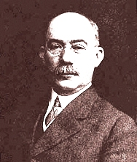
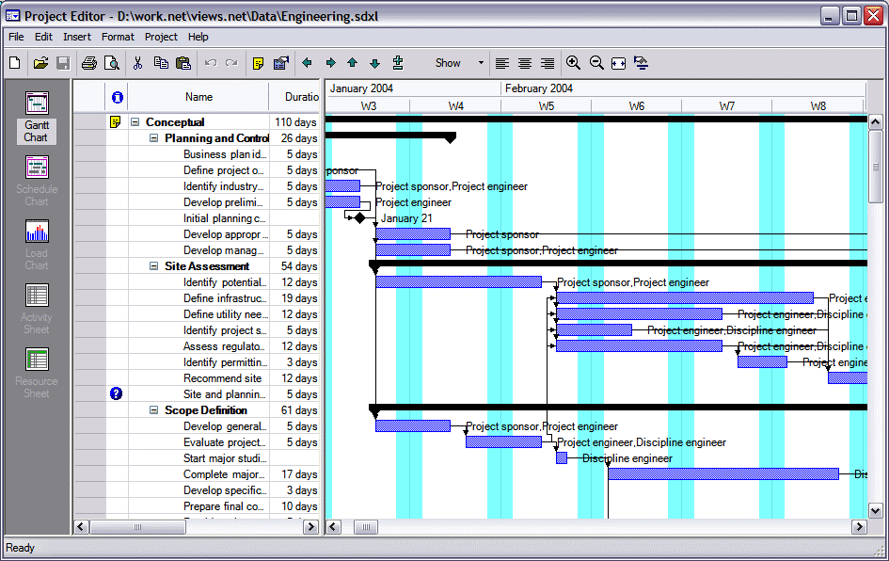
Depicting Schedules
Gantt Charts one standard tool
▪ In use since 1910's
▪ Common for representing PDM-style
schedules
Schwalbe, Kathy, Information Technology Project Management, 6th Ed.

Slide 10
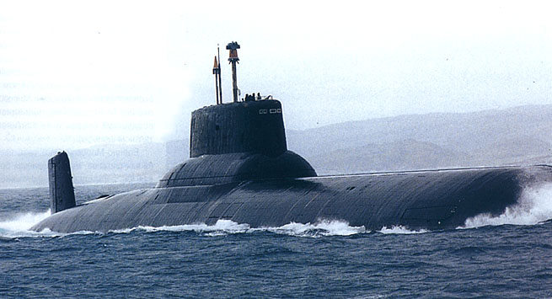
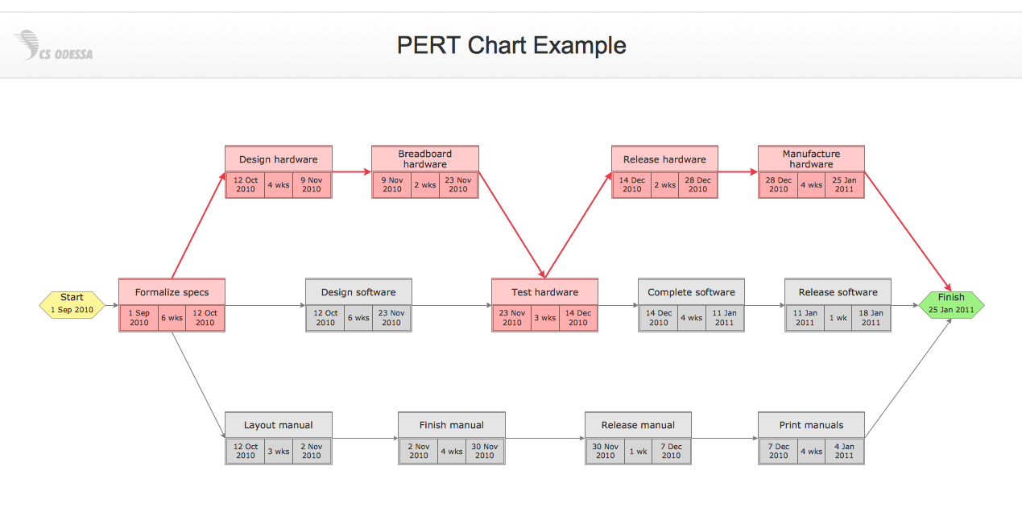
Depicting Schedules
PERT charts
▪ Project Evaluation and Reporting Technique
▪ Developed by U.S. Dept. of Defense
in 1958 for Polaris submarine project
▪ Theoretically equivalent to Gantt Charts, but in different format
http://filebox.vt.edu/users/sfury/3434/history.html

Slide 11
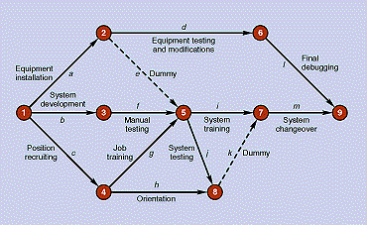
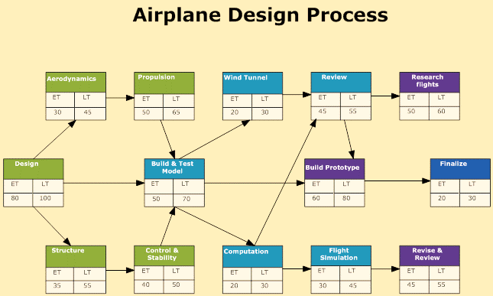
PERT Chart Types
▪ activity-on-arrow (AOA)
▪ a.k.a. arrow diagramming method (ADM)
▪ support only finish-start
dependencies
▪ use dummy tasks to capture other types of dependencies
▪ activity-on-node (AON)
▪ a.k.a. precedence diagramming method (PDM)
▪ preferred style of graph
Schwalbe, Kathy,
Information Technology Project Management, 6th Ed.

Slide 12
Scheduling - Pragmatics
Scheduling a difficult problem, even with perfect knowledge of time, resource requirements
▪ Realistically, NP complete
▪ Intuition: time to find optimal schedule probably (though not provably at this time) exponential in number of tasks
Critical path scheduling
▪ Classic, effective heuristic for resource allocation
▪ Strategy
▪ Identify path through schedule that takes most time, assuming unbounded resources
▪ Allocate resources along this path

Slide 13
Scheduling - Critical Chain Scheduling
Similar to critical path scheduling, except in three regards
▪ Focuses on longest path through schedule after resource allocation
▪ Critical path = critical chain with unbounded resources
▪ Involves tradeoffs, due to options for resource allocation
▪ Adjustments typically involve calculating float
▪ Max delay in an activity's start with no impact on schedule
▪ Free float - relative to immediate successor activities
▪ Total float - relative to overall project delivery
▪ To paraphrase: how long an activity can be delayed without
delaying completion of immediate successors/ overall project
▪ Also called slack
▪ Adds buffers to schedule to account for variance
▪ Feeder buffers where non-critical chains meet critical chain
▪ Project buffer at critical chain's end
Schwalbe, Kathy, Information Technology Project Management, 6th Ed.

Slide 14
Tools for Controlling Schedules
▪ Scheduling tools (e.g., MS Project)
▪ Progress reports
▪ Variance analysis - e.g., analyzing float (slack)
▪ What-if scenario analysis
▪ Adjusting leads and lags
▪ Performance measurement
▪ Change control system for managing schedules
Schwalbe, Kathy, Information Technology Project Management, 6th Ed.

Slide 15
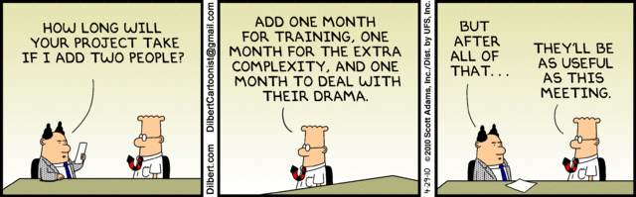
Strategies for Accelerating Schedules
▪ Referred to as schedule compression
▪ Goal: preserve project scope while reducing duration
▪ Strategies
▪ Crashing - adding resources (at added cost)
▪ Fast-tracking - overlapping or parallelizing tasks that should be sequenced (but risks rework due to unexpected errors)
▪ Best case: typically 25% compression (McConnell)
▪ Worst case: compression delays completion
▪ outcome when time to integrate new resources exceeds benefit
▪ captured by Brooks' Law – "Adding manpower to a late software project makes it later" (F. Brooks, The Mythical Man Month)

Slide 16
Making Schedules Central: Henry
▪ Project manager must champion the schedule
▪ Put schedule at center of all communications
▪ Team meetings
▪ Written communications
▪ Informal meetings of all sorts
▪ Relate schedule to tasks, events, and issues
▪ Relate tasks and task progress to schedule
What this accomplishes
▪ Pushes team to meet schedule (professionalism)
▪ Measures team progress throughout
Henry, Joel, Software Project Management: a Real-World Guide to Success

Slide 17
Schedules and Weekly Meetings
Goals: keep schedule visible; identify slippage early
Before meeting: review schedule
During meeting:
▪ Throughout: keep current schedule before team
▪ When discussing each role, include schedule impact
▪ Ask entire team if people see impact
▪ Include schedule review
▪ Ask each team member if (s)he is on schedule
▪ Ask each team member about potential problems
▪ Recap what was stated, agreed to, identified as risk
After meeting: update schedule, archive
Henry, Joel, Software Project Management: a Real-World Guide to Success

Slide 18
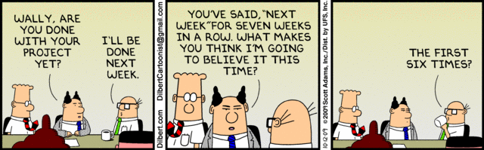
Using Schedules to Manage Slippage
Identify slipped tasks
Quantify slippage to assess quality of estimates
▪ As pct. of amount of slippage (less = better)
▪ At point in task when slippage occurred (later = better)
Identify dependencies on slipped tasks
▪ True dependencies
▪ Resource dependencies
Develop best-, likely-, and worst-case estimates
Henry, Joel, Software Project Management: a Real-World Guide to Success

Slide 19
Rescheduling After Slippage
Decide if forward or backward scheduling required
▪ Forward: if delivery date can slip
▪ Backward: if delivery date fixed
Forward scheduling
▪ Estimate slippage
▪ Consider if new schedule is realistic
▪ Reschedule related tasks
Backward scheduling
▪ Consider adding resources
▪ Consider reducing scope
▪ Common error: reducing investment in quality control
Document, review, revise schedule
Henry, Joel, Software Project Management: a Real-World Guide to Success

Slide 20
Project Scheduling Tools
Dissatisfaction with inexpensive tools is classic
What follows: brief (and hardly definitive) review of some concerns and tools related to schedule management

Slide 21
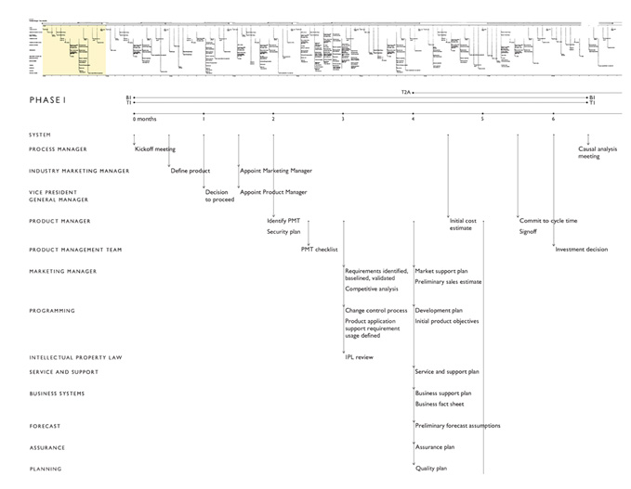
Edward Tufte (2002)

Slide 22
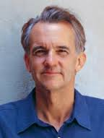
Tufte's Critique of Scheduling Tools
Tufte: well-known authority on user interfaces and visualization
  e.g., Power Point's impact on the Columbia shuttle disaster: (http://www.edwardtufte.com/bboard/q-and-a-fetch-msg?msg_id=0001yB&topic_id=1)
Concerns:
  Most charts: thin, too simple, lack substantive detail.
  At minimum, annotations needed: e.g., to-do lists.
(see http://www.edwardtufte.com/bboard/q-and-a-fetch msg?msg_id=000076)

Slide 23
Martin Ternouth (2002)
Needed: 3m x 1m screens with 150dpi resolution
For now: display day-by-day on wall chart from Excel.
▪ Print on (say) 21, 24, 27 sheets of paper.
▪ Cut and paste physically. Stick on the wall.
▪ Hold all project discussions in front of it
▪ Write all comments, ideas, issues, problems, etc. on it.
▪ Get Project Leaders to behave the same remotely.
At the end of each week collate all comments, enter on master digital version, reprint and rehang on the wall.
▪ Takes an hour or so, but it is worth it.
▪ Keep previous comments, errors, old items. Might
become relevant again.

Slide 24
Martin Ternouth (cont.)
Wall document (and remote duplicates) becomes a living sand table that takes immediate imprint of activity.
▪ People stand in front of it and read it in idle moments.
▪ CEOs and the President wander in, note things,
ask questions, nod, go away satisfied.
▪ Occasionally someone will point to an item in one corner and gaze to another corner and ask,
"You don't think these two issues are connected,
do you?"
Related suggestion: save time by printing on 36" x 150" plotter paper.

Slide 25
Additional Suggestions for Wall Charts
Varying color
Varying line thickness
Post-it notes
Images
Leveling (i.e., broad view with drill-down)
Put names of activities on bars themselves
Use rolls of poster paper (a.k.a. butcher paper)

Slide 26
Response: Hussain Mooraj
770 ll./ 18 pp. too large for Gantt
Divide into smaller phases
Show phases in detail
Response: "Andrea"
Expensive tools offer leveling
Draw initial plan manually
▪ colored pens
▪ sticky notes
▪ 11x17 paper

Slide 27
Gantt Charts As Problematic Tools
I hate Gantt Charts. I loathe MS Project. - Digby
▪ Don't show chains of dependencies
▪ Don't show earned value
Don't show multiple levels (Alan Robataille)
▪ Upper management wants quick details with
support for asking micromanagement questions
▪ Mid management wants details in their areas
▪ Other contributors want to see all they'll be doing
▪ Samples for all standard products difficult to update quickly at all levels

Slide 28
Various Recommendations
Primavera Teamplay (http://www.stenstromgroup.com/)
Advanced Experience
▪ Tool with special, simplified chart - "project chart"
▪ Trial download: http://www.axproject.com/download

